Slide 1
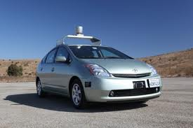
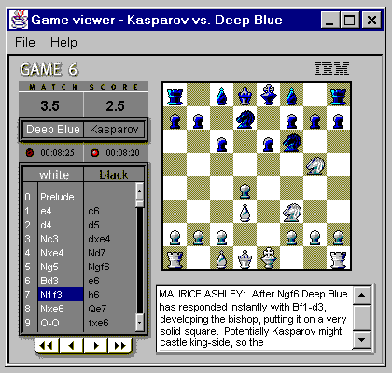
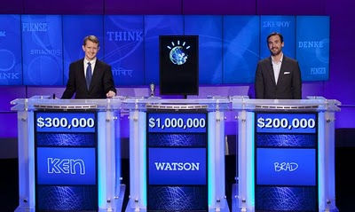
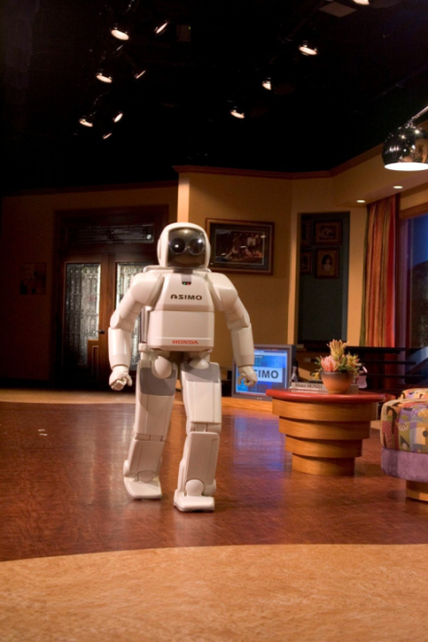

CS 5/7320 Artificial Intelligence Introduction AIMA Chapter 1
Slides by Michael Hahsler based on slides by Svetlana Lazepnik with figures from the AIMA textbook.
This work is licensed under a Creative Commons Attribution-ShareAlike 4.0 International License.

Slide 2
Topics
What is AI?
AI Today
History of AI
AI Ethics

Slide 3
What is AI?
ASIMO (Advanced Step in Innovative Mobility) is a humanoid robot created by Honda in 2000

Slide 4
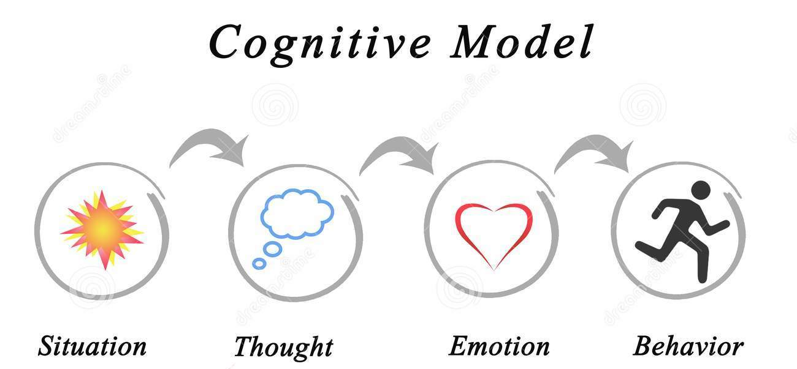
What is it the goal of AI?
Artificial Intelligence (AI) and how it's applied in the real world.
Cognitive Modeling that deals with simulating the human thinking process
thinks like a human?
acts like a human?
thinks rationally?
acts rationally?
Create an agent that

Slide 5
Thinking Like a Human
The brain as an information processing machine.
How to understand cognition as a computational process?
Introspection: try to think about how we think.
Predict the behavior of human subjects.
Image the brain, examine neurological data
Requires scientific theories of how the brain works
= Cognitive Sciences

Slide 6
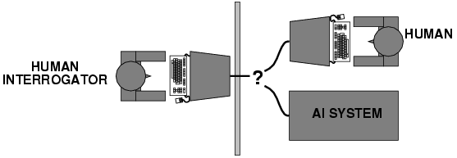
Acting Like a Human
Alan Turing (1950) "Computing machinery and intelligence"
The Turing Test tries to define what acting like a human means
What capabilities would a computer need to have to pass the Turing Test?
Natural language processing
Knowledge representation
Automated reasoning
Probably also machine learning
Turing predicted that by the year 2000, machines would be able to fool 30% of human judges for five minutes.

Slide 7
Turing Test: Criticism
What are some potential problems with the Turing Test?
Some human behavior is not intelligent.
Some intelligent behavior may not be human.
Human observers may be easy to fool
A lot depends on expectations
Anthropomorphic fallacy (humans tend to humanize things)
Chatbots, e.g., ELIZA imitate without intelligence.
Chinese room argument: one may simulate intelligence without having true intelligence (more of a philosophical objection)
Is passing the Turing test a good scientific goal?
Engineering perspective: Not a good way to solve practical problems.
We can create intelligent agents without trying to imitate humans.

Slide 8

Thinking rationally
Idealized or “right” way of thinking.
Logic: patterns of argument that always yield correct conclusions when supplied with correct premises
“Socrates is a man; all men are mortal; therefore Socrates is mortal.”
Beginning with Aristotle, philosophers and mathematicians have attempted to formalize the rules of logical thought.
Logic-based approach to AI: describe problem in formal logical notation and apply general deduction procedures to solve it
Problems with the logic-based approach to AI
Describing real-world problems and knowledge in logical notation.
Computational complexity of finding the solution.
A lot of intelligent or “rational” behavior in an uncertain world has nothing to do with logic.
What about the following logical implication:
$study hard \underset{⇒}{}A in AI$

Slide 9
Acting rationally: Rational agent
A rational agent acts to achieve the best expected outcome:
Goals are application-dependent and are expressed in terms of the utility of outcomes.
Being rational means acting to maximizing your expected utility. Expectation means that different outcomes are possible (probabilities).
In practice, utility optimization is subject to the agent’s computational constraints (bounded rationality or bounded optimality).

Slide 10
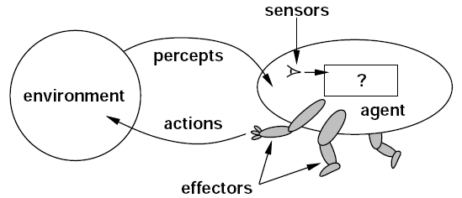
Acting rationally: Rational agent
Advantages of the “expected utility maximization” formulation
Generality: an optimization that goes beyond explicit reasoning with rules.
Practicality: can be adapted to many real-world problems.
Amenable to good scientific and engineering methodology including simulation and experimentation.
Only concerns the decisions/actions that are made, not the cognitive process behind them. Avoids philosophy and psychology (at least mostly) in favor of a clearly defined objective.

Slide 11
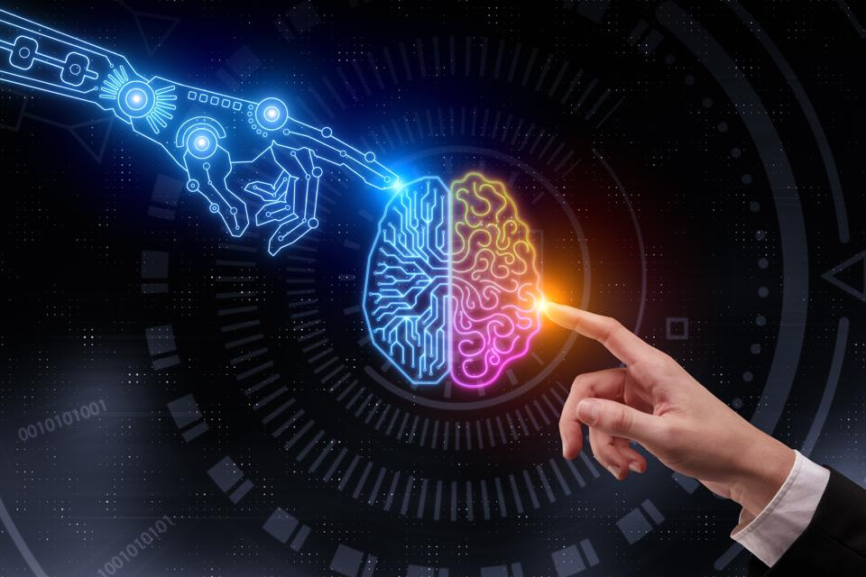
What is AI
Artificial Intelligence (AI) is a way to make machines think and behave intelligently
Different researchers focus on different concepts to define AI
AI is closely related to the study of human brain.
Researchers believe that AI can be accomplished by understanding how the human brain works.

Slide 12
Why AI
AI has the ability to impact every aspect of our lives.
The field of AI tries to understand patterns and behaviors of entities.
Smart Systems
Working of Human Brain
Expert Machines
Assist Humans
Work Autonomously

Slide 13
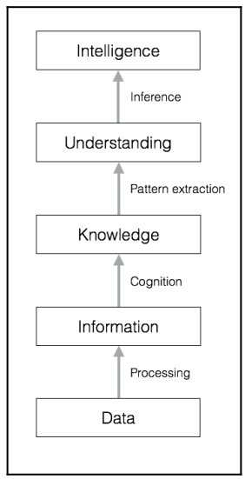
Data to Wisdom
Data
The raw fact and figures that we give as input to machines
Information
Processed data that is easy to understand by humans
Knowledge
Collection of information with its associated context.
The context is in the form of relationships between information sets collected over time.
Knowledge is the outcome of experience working with a pool of information.
Understanding
What knowledge part is related to what other part
Intelligence Wisdom
It is the ability to select the best way to reach the desired outcome based on knowledge.
Wisdom is the outcome of experience from or knowledge of earlier attempts to reach a successful outcome.

Slide 14
AI Connections
Philosophy logic, methods of reasoning, mind vs. matter, foundations of learning and knowledge
Mathematics logic, probability, optimization
Economics utility, decision theory
Neuroscience biological basis of intelligence
Cognitive science computational models of human intelligence
Linguistics rules of language, language acquisition
Machine learning design of systems that use experience to improve performance

Slide 15
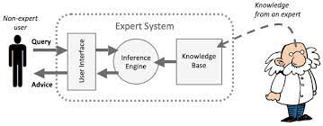
Applications of AI
Computer Vision
Autonomous cars
Medical image analysis
Biological networks
Natural Language Processing
Speech Recognition systems
Expert Systems
Games
Robotics

Slide 16
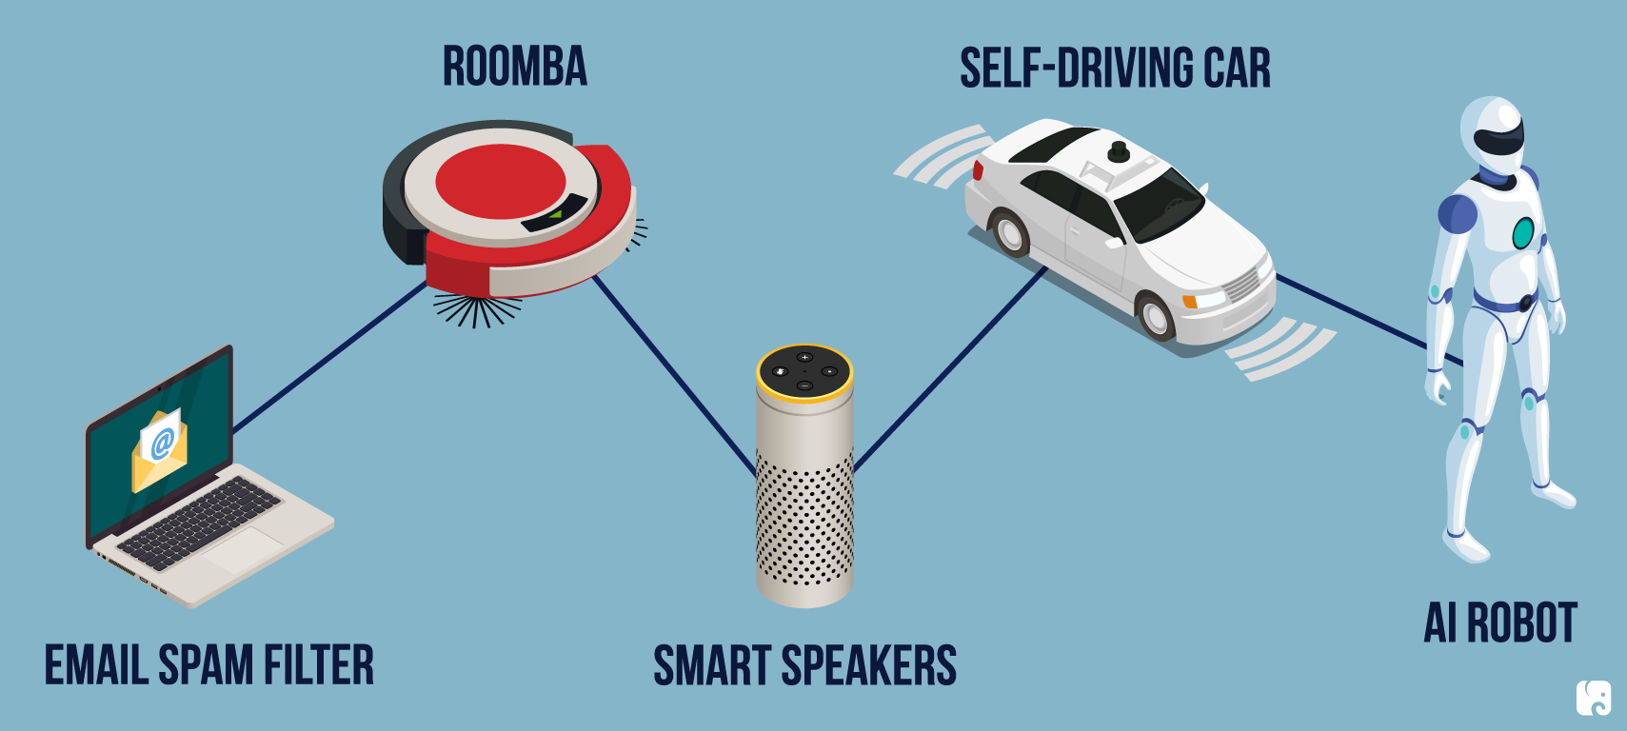
AI Today

Slide 17
IBM Watson
http://www.research.ibm.com/deepqa/
NY Times article
Trivia demo
YouTube video
IBM Watson wins on Jeopardy (February 2011)

Slide 18
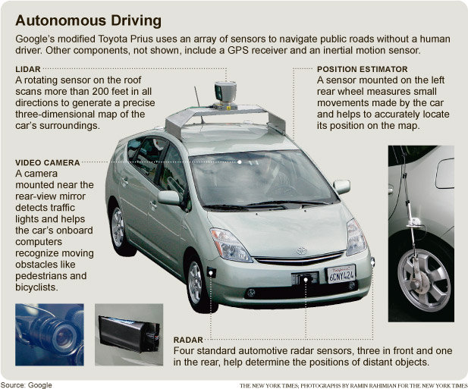

Slide 19
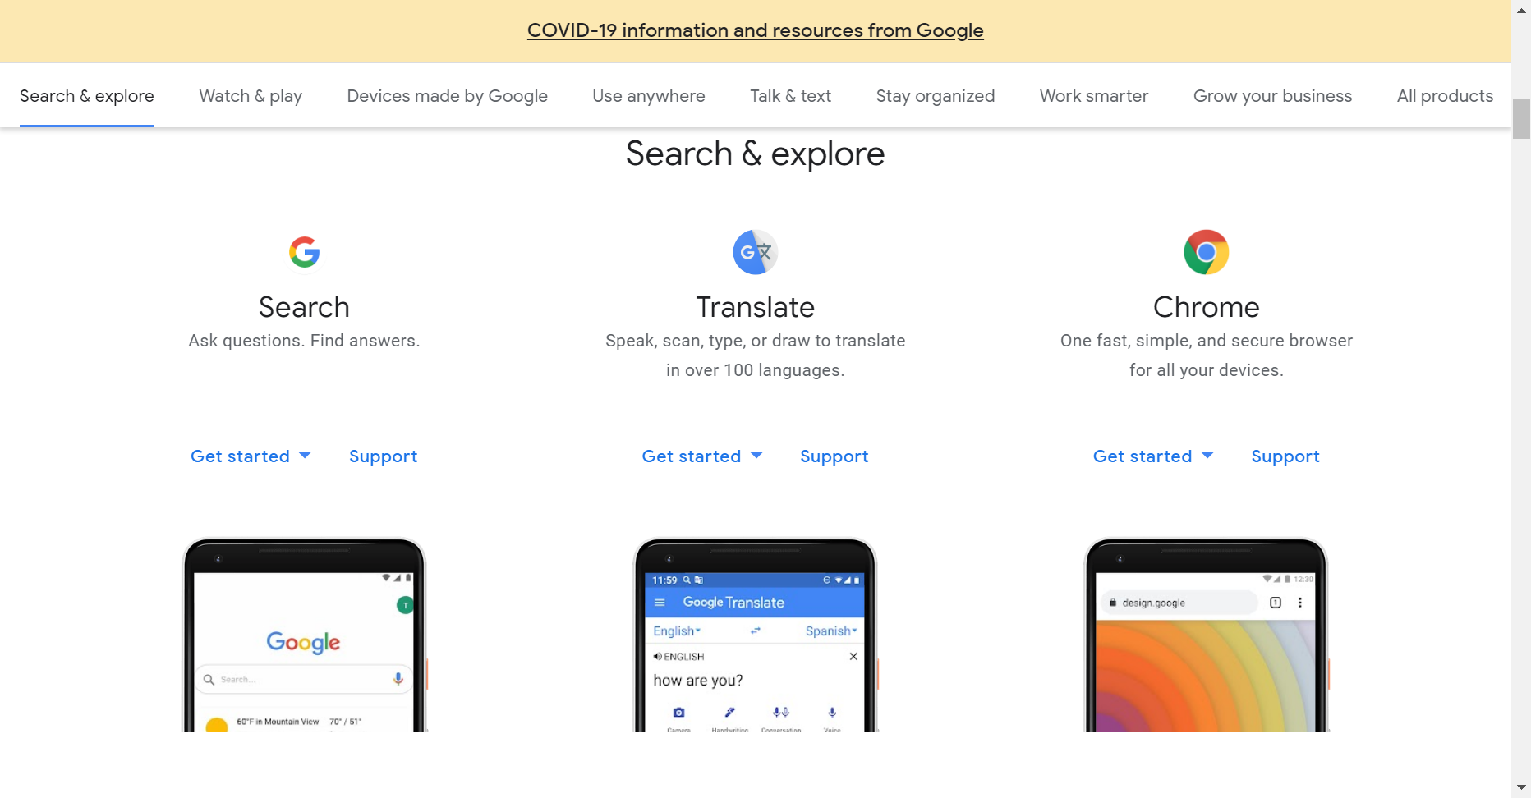
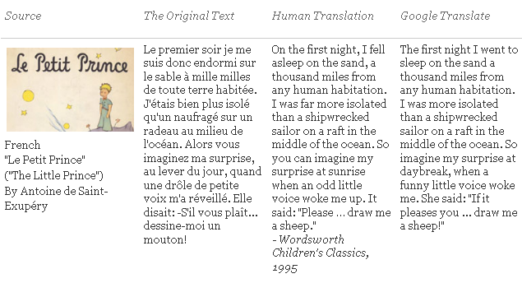
Natural Language
Speech technologies
Text-to-speech synthesis
Automatic speech recognition
Google voice search
Machine translation
translate.google.com
Comparison of several translation systems

Slide 20
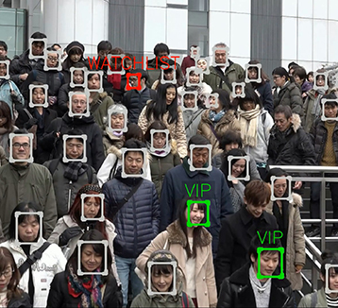
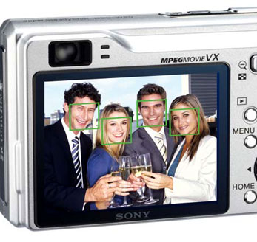


Vision
OCR, read license plates, handwriting recognition (e.g., mail sorting)
Face detection/recognition: now standard for smart phone cameras
Visual search: Google Google Lense
Vehicle safety systems: Mobileye

Slide 21

Math, games, puzzles
1996: A computer program written by researchers at Argonne National Laboratory proved a mathematical conjecture (Robbins conjecture) unsolved for decades
NY Times story: “[The proof] would have been called creative if a human had thought of it”
1996/97: IBM’s Deep Blue defeated the reigning world chess champion Garry Kasparov in 1997
1996: Kasparov Beats Deep Blue “I could feel --- I could smell --- a new kind of intelligence across the table.”
1997: Deep Blue Beats Kasparov “Deep Blue hasn't proven anything.”
2007: Checkers was “solved” --- a computer system that never loses was developed. Science article
2017+: AlphaZero learns chess, shogi and go by playing itself. Science article

Slide 22
Logistics Scheduling Planning
1991
During the 1991 Gulf War, US forces deployed an AI logistics planning and scheduling program that involved up to 50,000 vehicles, cargo, and people
May 1999
NASA’s Remote Agent software operated the Deep Space 1 spacecraft during two experiments in May 1999
2004
In 2004, NASA introduced the MAPGEN system to plan the daily operations for the Mars Exploration Rovers
2018
Optimized Prime: How AI And Anticipation Power Amazon's 1-Hour Deliveries

Slide 23
Information agents
Search engines
Recommendation systems
Spam filtering
Automated helpdesks
Medical diagnosis systems
Fraud detection
Automated trading

Slide 24
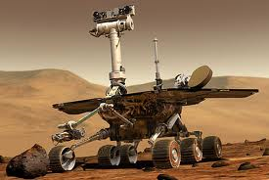
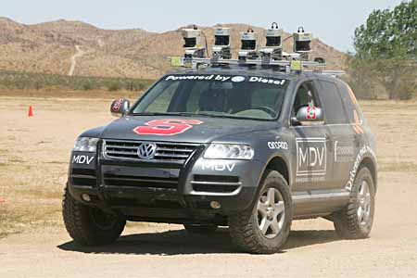

Robotics
Mars rovers
Autonomous vehicles
DARPA Grand Challenge
Google self-driving cars
Autonomous helicopters and drones
Robot soccer
RoboCup
Personal robotics
Humanoid robots
Robotic pets
Personal assistants?

Slide 25
Branches of AI
Machine learning and pattern recognition
Logic-based AI
Search
Knowledge representation
Planning
Heuristics
Genetic programming
Notes:
an educated guess on what approach we should take to solve a problem

Slide 26
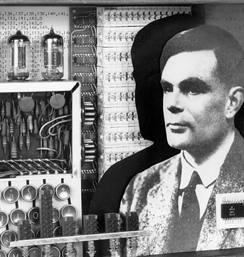
History of AI

Slide 27
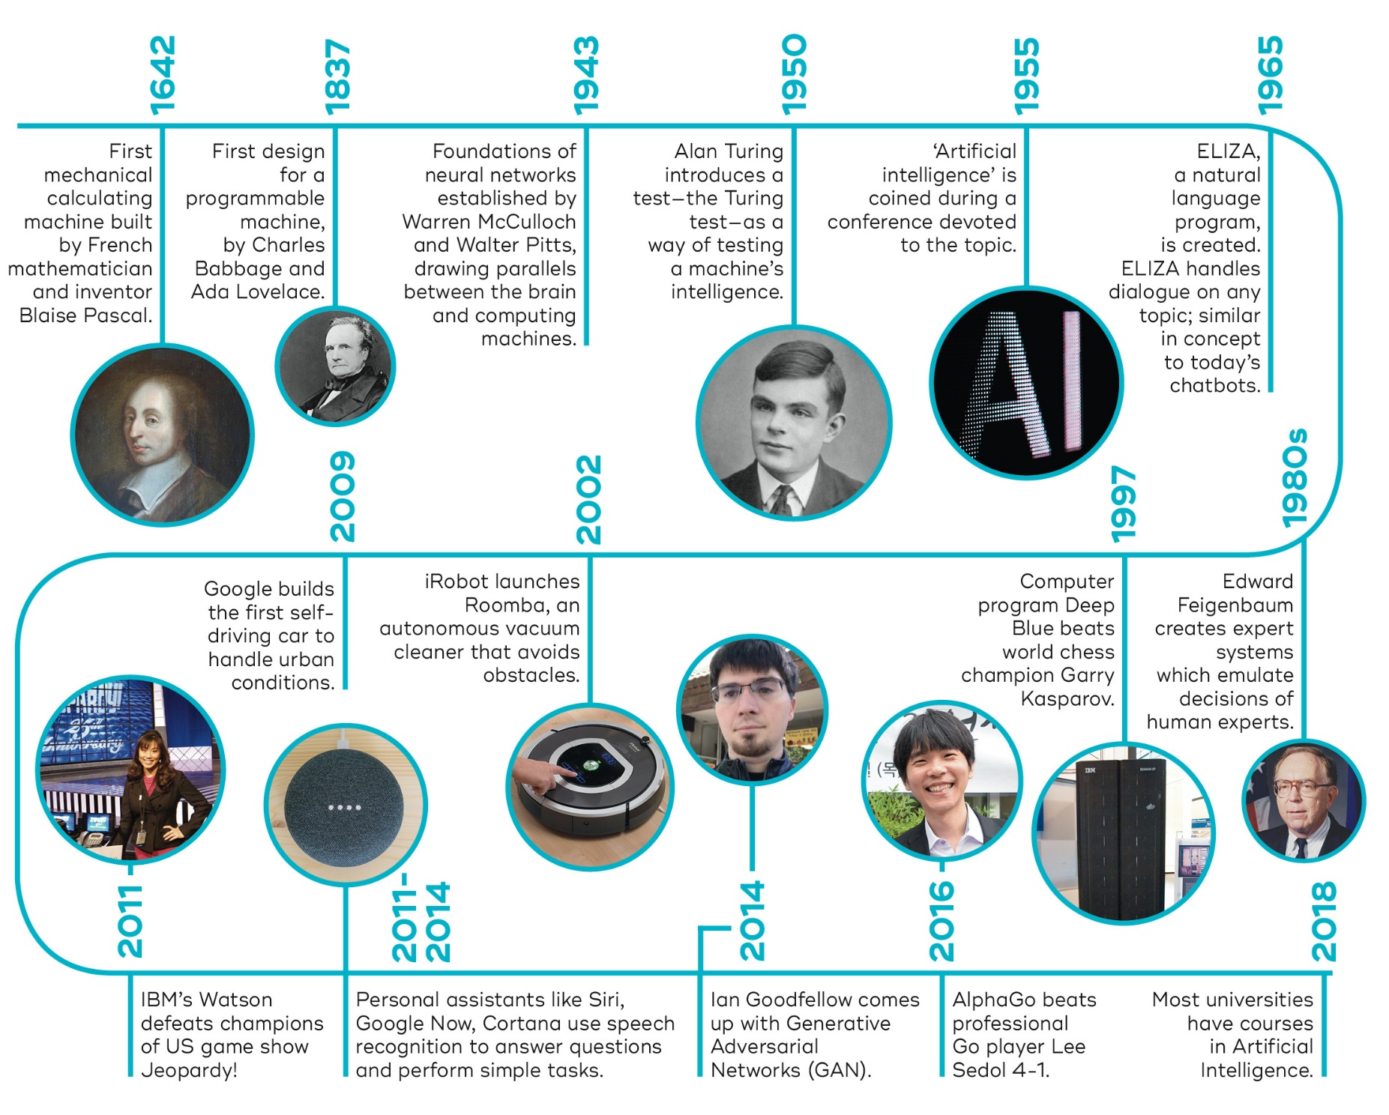
…
Source: https://qbi.uq.edu.au/brain/intelligent-machines/history-artificial-intelligence

Slide 28
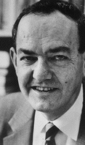
AI is harder than originally thought Herbert Simon, 1957
“It is not my aim to surprise or shock you--- but … there are now in the world machines that think, that learn and that create. Moreover, their ability to do these things is going to increase rapidly until---in a visible future---the range of problems they can handle will be coextensive with the range to which human mind has been applied. More precisely: within 10 years a computer would be chess champion, and an important new mathematical theorem would be proved by a computer.”
Simon’s prediction came true --- but 40 years later instead of 10

Slide 29
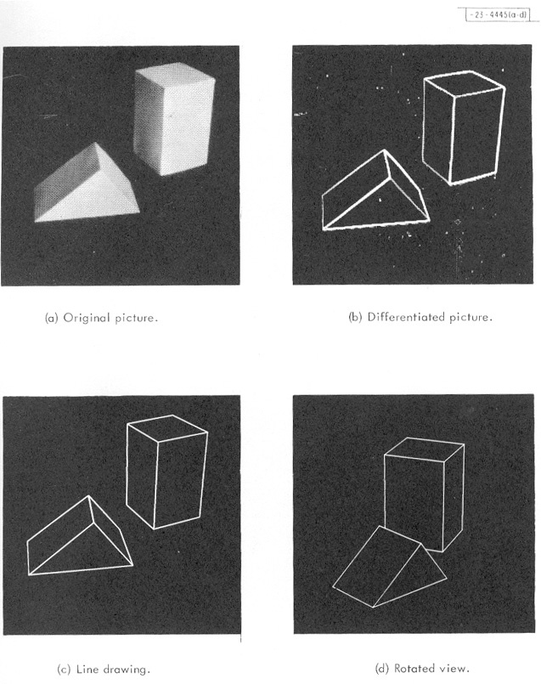

Blocks world (1960s – 1970s)
???
Roberts, 1963

Slide 30
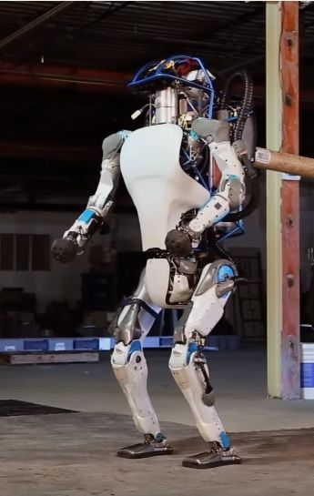
“Moravec’s Paradox”
Hans Moravec (1988): “It is comparatively easy to make computers exhibit adult level performance on intelligence tests or playing checkers, and difficult or impossible to give them the skills of a one-year-old when it comes to perception and mobility.”
Why is this?
Early AI researchers concentrated on the tasks that “white male scientists” found the most challenging, abilities of animals and two-year-olds were overlooked.
We are least conscious of what our brain does best.
Sensorimotor skills took millions of years to evolve.
Our brains were not designed for abstract thinking.
https://www.newsweek.com/googles-new-two-legged-robot-future-warfare-429831

Slide 31
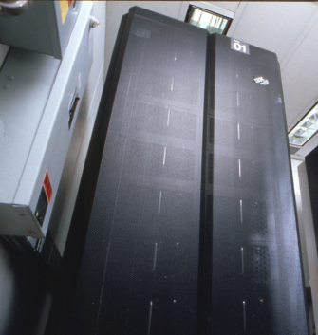
What accounts for recent successes in AI?
Faster computers
The IBM 704 vacuum tube machine that played chess in 1958 could do about 50,000 calculations per second
Deep Blue could do 50 billion calculations per second – a million times faster!
Lots of storage (Cloud)
Lots of data (Sensors, IoT)
Dominance of statistical approaches, machine learning, deep learning.

Slide 32
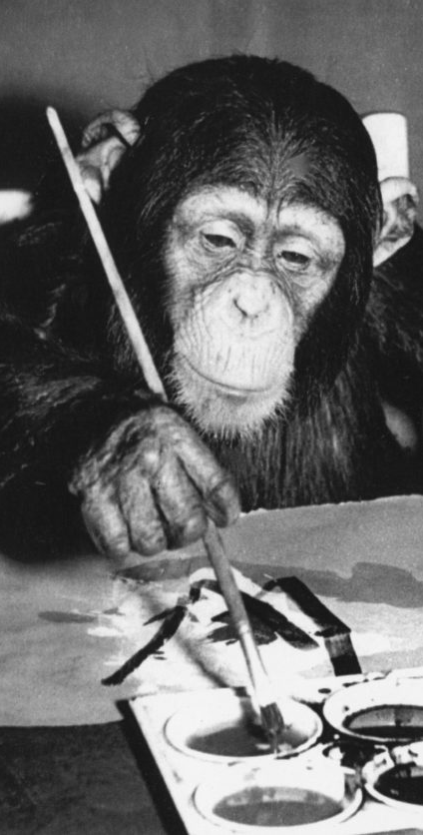
AI gets no respect?
AI effect: As soon as a machine gets good at performing some task, the task is no longer considered to require much intelligence
Calculating ability used to be prized – not anymore
Chess was thought to require high intelligence
Now, massively parallel computers essentially use brute force search to beat grand masters
Learning once thought uniquely human
Ada Lovelace (1842): “The Analytical Engine has no pretensions to originate anything. It can do whatever we know how to order it to perform.”
Now machine learning is a well-developed discipline
Similar picture with animal intelligence

Slide 33
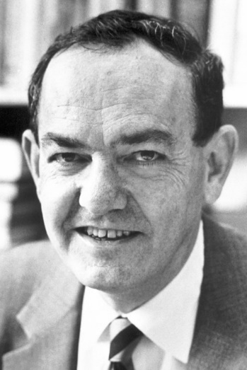
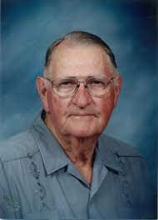
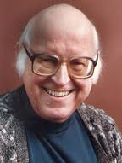
General Problem Solver
AI program proposed by Herbert Simon, J.C. Shaw, and Allen Newell.
first useful computer program that came into existence in the AI world
The goal was to make it work as a universal problem-solving machine
it could only solve well-defined problems
But in the real world, this quickly becomes intractable because of the number of possible paths you can take.
If it tries to brute force a problem by counting the number of walks in a graph, it becomes computationally infeasible

Slide 34
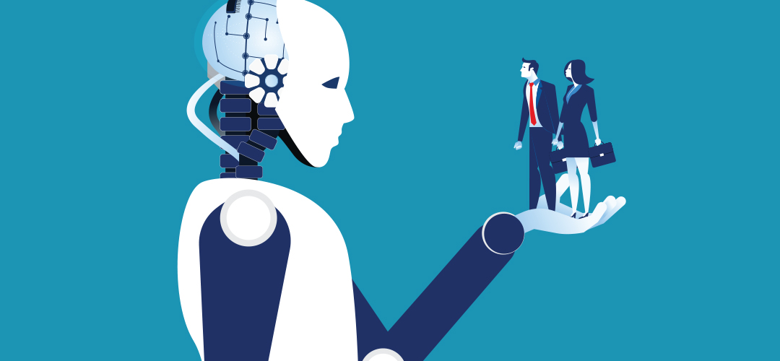
AI Ethics
A new Frontier for Fairness and Freedom

Slide 35
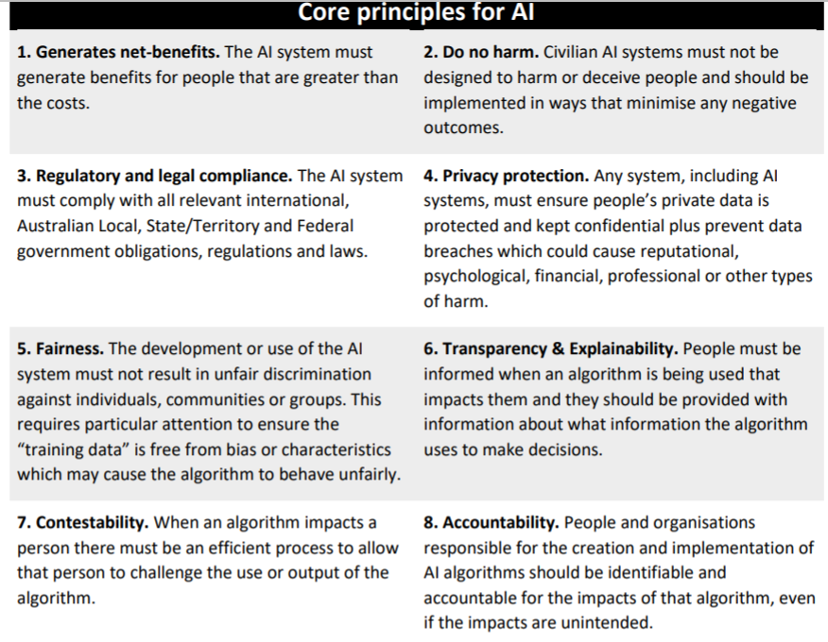
Australia: AI Ethics Framework for Industry A set of voluntary AI Ethics Principles (2019)
https://consult.industry.gov.au/strategic-policy/artificial-intelligence-ethics-framework/supporting_documents/ArtificialIntelligenceethicsframeworkdiscussionpaper.pdf

Slide 36
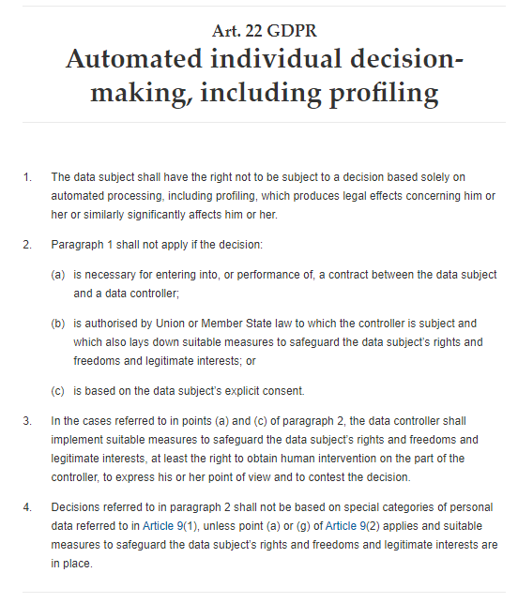
European Union
Has regulations since 2016 included in the General Data Protection Regulation (GDPR)
Art. 22 GDPR – Automated individual decision-making, including

Slide 37
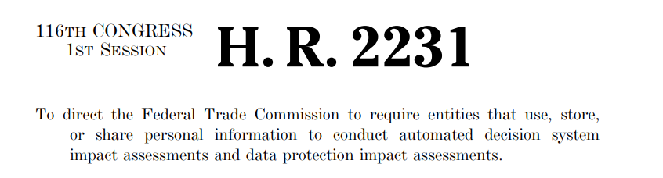
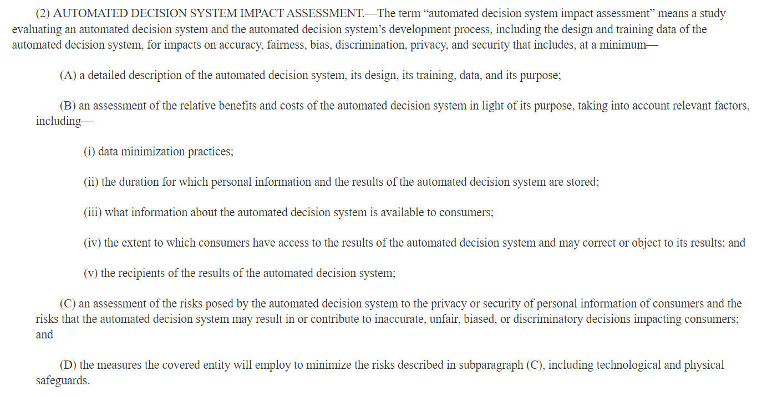
The US
Bill Introduced in 2019
Did not receive a vote in Congress.

Slide 38
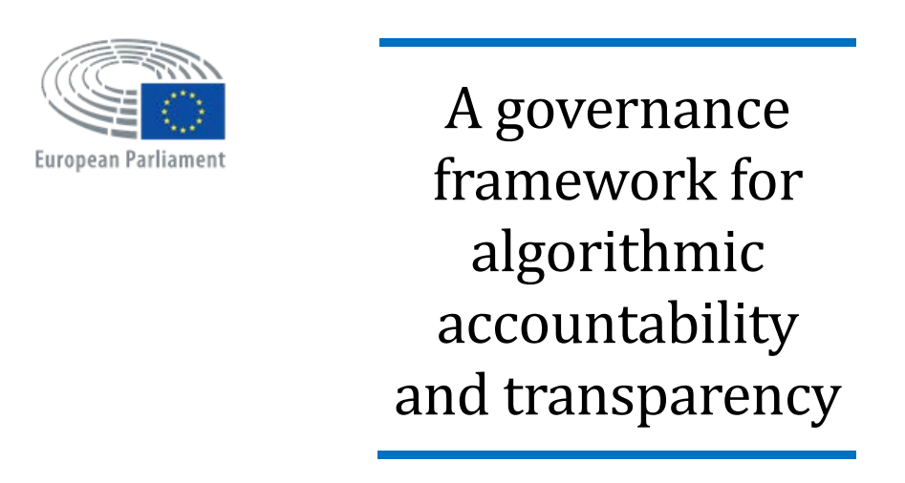
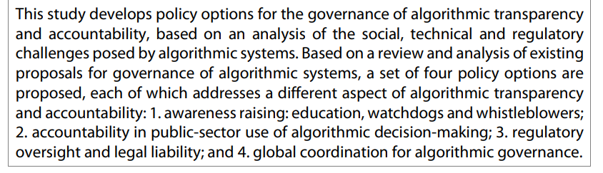
European Union Study (2019)
https://www.europarl.europa.eu/thinktank/en/document.html?reference=EPRS_STU(2019)624262

Slide 39
Algorithmic Bias and Fairness
“Algorithmic bias describes systematic and repeatable errors in a computer system that create unfair outcomes, such as privileging one arbitrary group of users over others” Wikipedia
Pre-existing bias
Social and institutional norms influence design and training data choices.
Technical bias
Limitations of a program or computational power.
Emergent bias
Use of algorithms for new data without checking for bias (e.g., existing correlations in the data).
For example: Evaluate job applicants for a job which is historically almost exclusively held by males.
For example: instead of a random sample, the program uses the first n data points.
Use of an algorithm for an unanticipated application.

Slide 40
What type of AI do we cover in this course?
thinks like a human?
acts like a human?
thinks rationally?
acts rationally.
Create an agent that
That is, use machines to solve hard problems that traditionally would have been thought to require human intelligence.

Slide 41
AI Models
Analytical Models
These models were derived using a mathematical formulation (Algorithm)
it was based on human judgment. Hence these models were simplistic and inaccurate with just a few parameters
Learned Models
These models are obtained through the process of training.
During training, the machines look at many examples of inputs and outputs to arrive at the equation.
These learned models are usually complex and accurate, with thousands of parameters.
This gives rise to a very complex mathematical equation that governs the data

